Slide 1
CKCC Gene Expression
And Their 95th Percentiles
Liam McKay
Treehouse Undergraduate Research

Slide 2
Overview
In pediatric patients: we look for genes highly expressed
We cut off at 95 Percentile of gene expression within the sample
What? - the genes with highest expression 5% in a sample
Why? - It’s a conservative measure with little doubt
Problems?
Are we losing data?
Can we reduce the stringency of 95 Percentile?
Slide Numbers
Notes:
We did find significant change in zeros

Slide 3
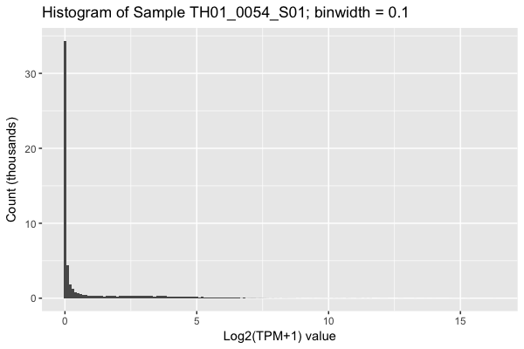
What does a single patient’s gene expression look like?
A lot of unexpressed genes
(assumed unexpressed)
~95th Percentile
Of TH01_0054_S01

Slide 4
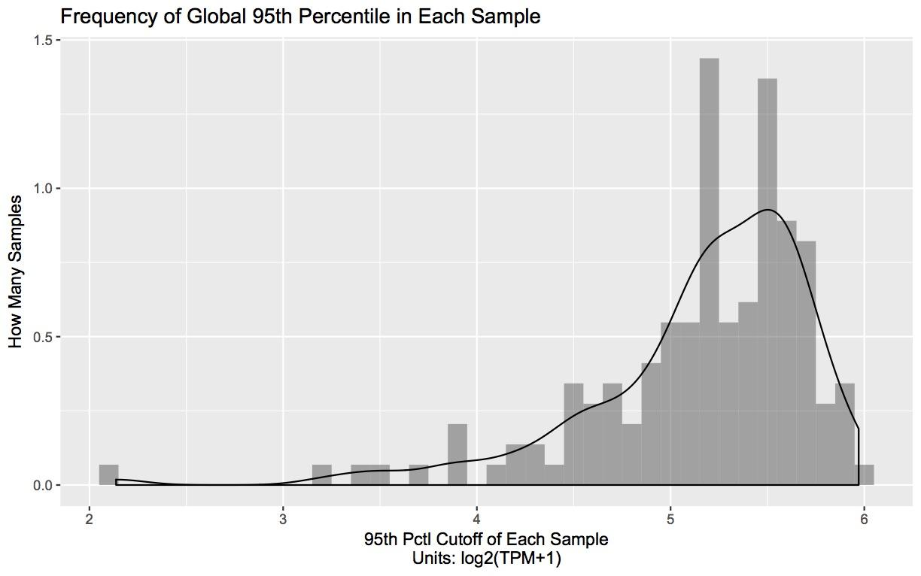
What does the 95th pctl look like across all patients?
These are percentile
cutoff values!
Bin = 0.1 log2(TPM+1)
High p95
What do these look like?
Low p95, what do these look like?
Why does this exist?
Notes:
Explain this more, its hard to understand
Each bar is how many samples had this 95th pctl

Slide 5
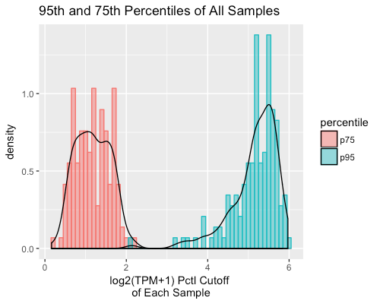
Skew is More Apparent in the 95th Pctl than 75th Pctl
75th
How Many Samples
Notes:
We checked the distribution at a lower percentile and the shape is different. We can’t investigate this using the p75, we have to use p95 (because no outliers)

Slide 6
Low vs. High 95th Percentiles
Is the quality of the patient genes expression related to its 95th pctl?
Is there something characteristic of a sample having high gene expression other than the 95th pctl

Slide 7
Time-out!
What is causing this low p95?
Is low p95 correlated to a major specific distribution change
There is no major systematic differences between high and low p95 histogram (yet)
Where are we going?
We need to find other ways to investigate low p95

Slide 8
How many unexpressed genes do samples have?
On average:
~50% of genes in each sample were unexpressed
There are differences in number of genes expressed in histograms
Are fewer genes expressed in samples with low 95th pctl
Specifically, are unexpressed gene counts higher in samples with a low 95th percentile?

Slide 9
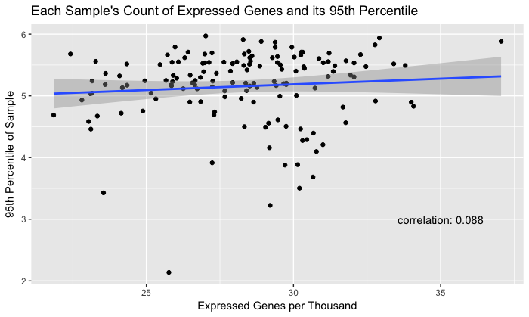
3. Across the cohort, the number of expressed genes not correlated to each patients’ 95th pctl
8.8% correlation
Best fit line shows flat correlation, however
We cannot conclude anything
Number of Expressed Genes (thousands)
Notes:
Uniquely mapped exonic nonduplicate (UMEND)
Uniquely mapped (UM)

Slide 10
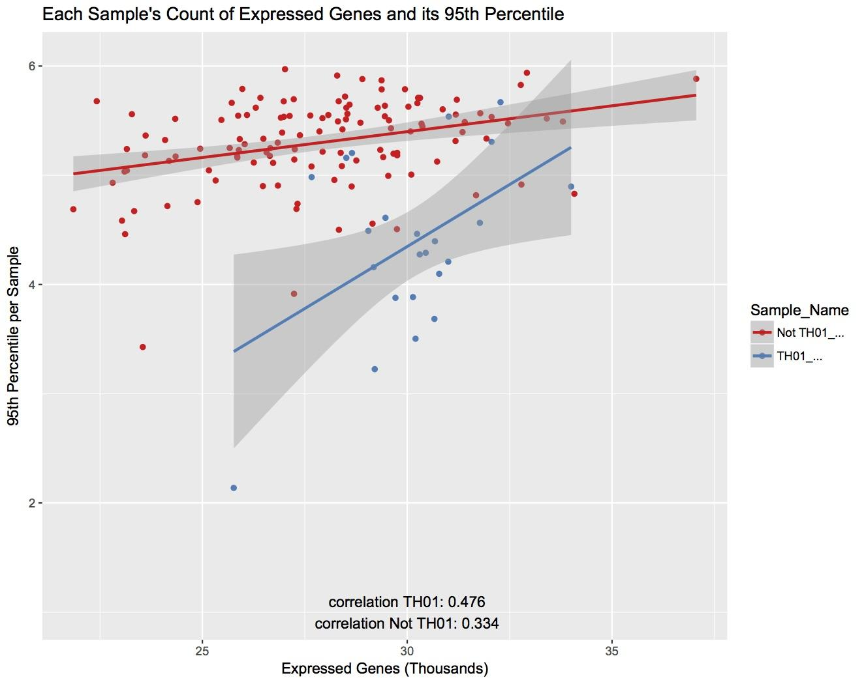
However, TH01*[RiboD] samples have ~50% correlation between p95 and # of Expressed Genes
Blue = TH01
Red = everything else
There is more correlation in TH01 than the rest
33.4% Not TH01 correlation
47.6% TH01 correlation
Number of Expressed Genes (thousands)

Slide 11
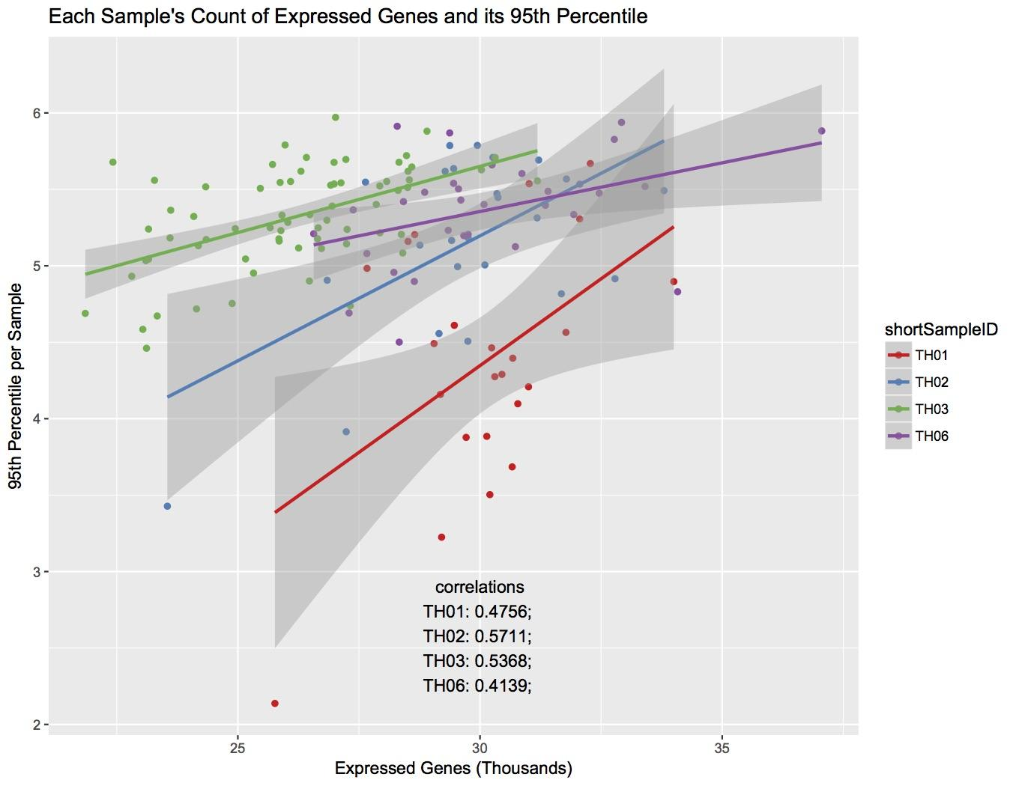
Substantial correlations are Present in the Data From Each CKCC
partner
TH02 has the highest correlation
TH01 47.56%
TH02 57.11%
TH03 53.68%
TH06 41.39%
Number of Expressed Genes (thousands)
Notes:
Much higher than when we didnt break out the center
Represents improvement based on library prep

Slide 12
Conclusion
There is a correlation between the number of expressed genes in a sample and its p95
But only apparent in samples that were prepared and sequenced by the same group
Next
We decided to investigate UMEND reads and p95 to find what else is causing low p95
Notes:
Error in rna extraction
If data came from one source
Then low p95 data would prob relaibly be have fewer expressed genes
Since having fewer expr genes is likely to represent an rna extr problem
Those are samples we would want to exclude anyway
This would solve p95 prob
But all don't come from the same sample center

Slide 13
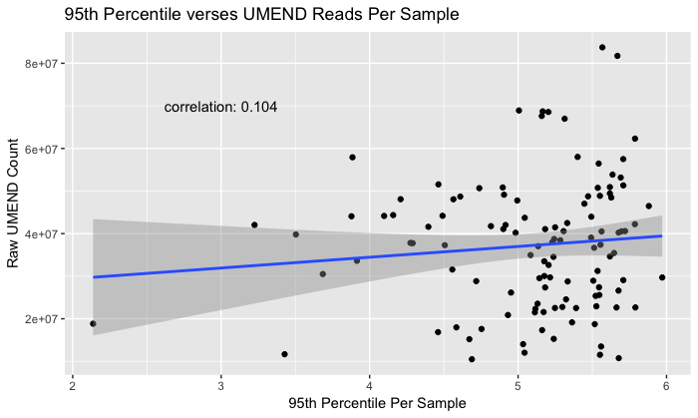
4. Across the cohort, the number of UMEND reads is not correlated to each patients’ 95th pctl
10.4% correlation
Notes:
We need to group them by center library prep type

Slide 14
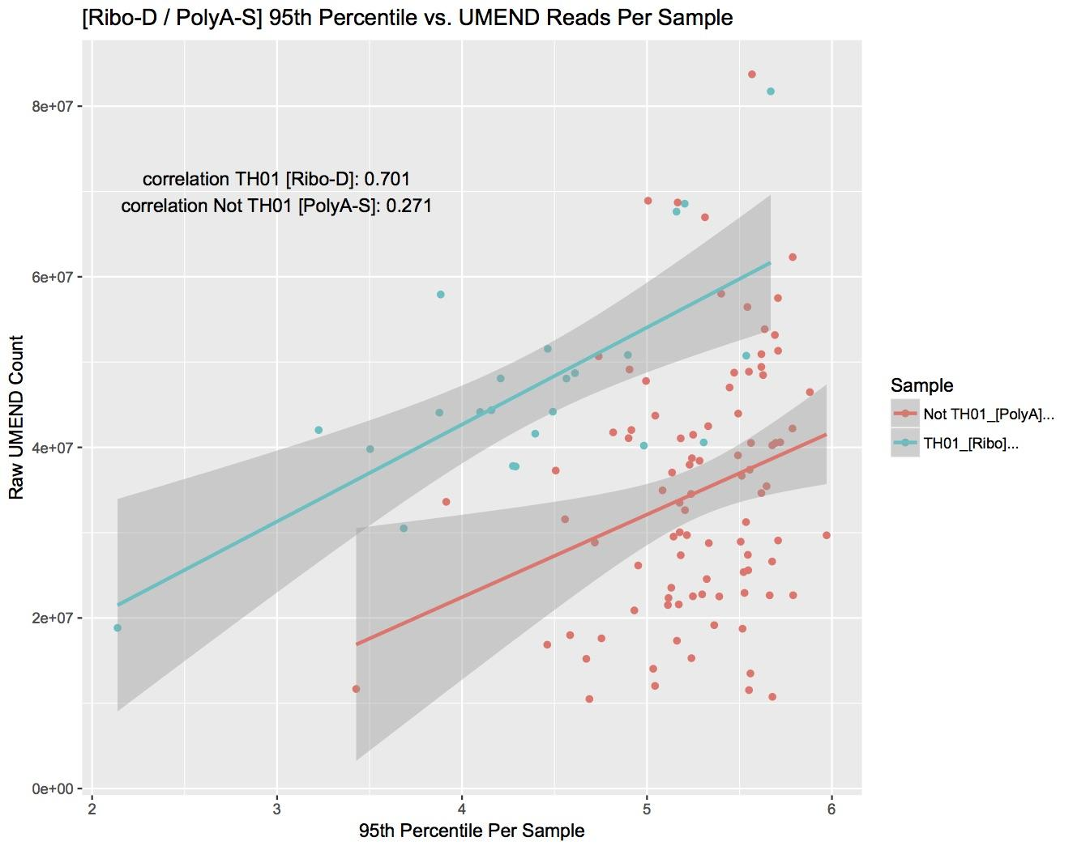
However, TH01*[RiboD] samples have ~70% correlation between
p95 and UMEND
riboD samples especially
RiboD has 70.1% correlation
PolyA-S 27.1%
Notes:
Color based off of th01,2,3,4,5,6 to rule out the noise within the two, that the points are fruther.
Is it ribo depleted or because ribo depeted is from one source polya multiple sources?
Show by center
If there is enough data per center parallel lines (maybe) the persons hands in the experiment differ within the compendium in the center it was measured at

Slide 15
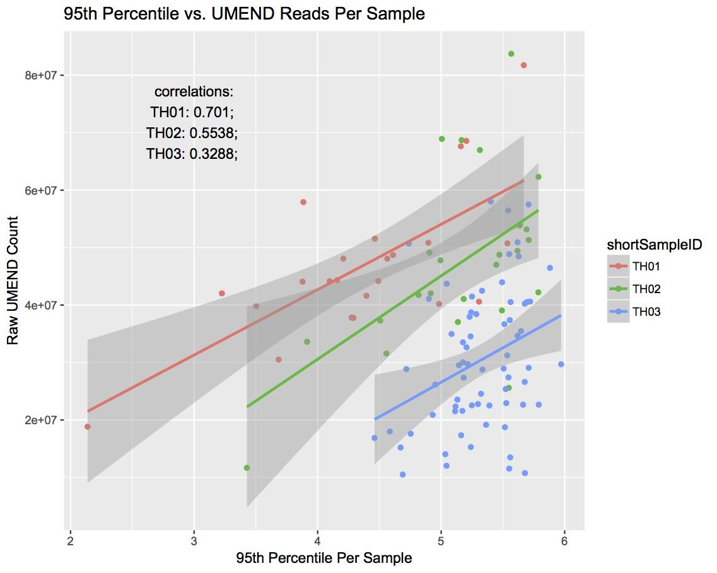
Again, Substantial correlations are Present in the Data From Each CKCC
partner
Separation by sample center
Shows TH01 has highest correlation
TH01 70.1%
TH02 55.38%
TH03 32.88%

Slide 16
Results
Plot every patient’s expression values (histograms)
There was half of the genes expressed (we assumed other half was unexpressed)

Slide 17
Results
Plot the distribution of 95pctl per sample
There are high and low 95th pctls
Why? because of UMEND / # of Expressed Genes

Slide 18
Results
Plot # of genes expressed vs. 95th pctl per sample
Looking at total ungrouped data there is no correlation
Each sample center = positive correlation p95/expression count (TH01: 47.6%)

Slide 19
Results
Plot UMEND count vs. 95th pctl pan-sample (scatter)
Looking at total ungrouped data there is no correlation
Each sample center = positive correlation p95/UMENDread (TH01: 70.1%)

Slide 20
What does it all mean?
There is a systematic difference between low p95 and high p95 using other investigations than just sample 95th percentile
UMEND, and number of expressed genes are correlated to the 95th percentile
More robust, less stringent statements about a sample’s p95
However, this systematic difference should be investigated with significance. (p<0.0005)

Slide 21
The End!
Questions?

Slide 22
Supplemental

Slide 23
RiboD vs. PolyA Selection
Non poly a doesn’t need to make a ton of copies for genes because its not going to be expressed
Poly A 95th percentile is therefore higher than non
Poly A
All rna is PolyA or non PolyA
PolyA has no ribosomal
Non PolyA has ribosomal
RiboD → sequence more of the total RNA than polyA
mRNA
Ribonuclease Depletion [RiboD]
Everything Not rRNA
mRNA, Non-PolyA-rRNA, polyA
Poly-A Selection [PolyA]
polyA
Non-polyA
RNA
polyA
RNA
rRNA

Slide 24
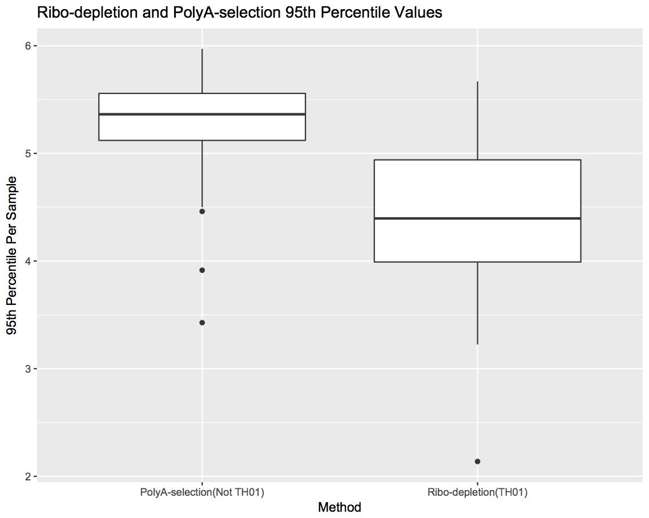
5. PolyA > RiboD
rel. p95
Welch Two Sample t-test
t = -5.3986,
df = 24.118,
p-value = 1.496e-05
alternative hypothesis:
true difference in means is not equal to 0
95 percent confidence interval:
-1.2779641 -0.5712024
sample estimates:
mean of x mean of y
4.374965 5.299548
COMPARE BY DATA HOUSE
Notes:
Polya line is higher in p95 on exrp gene vs p95 graph than ribo d

Slide 25
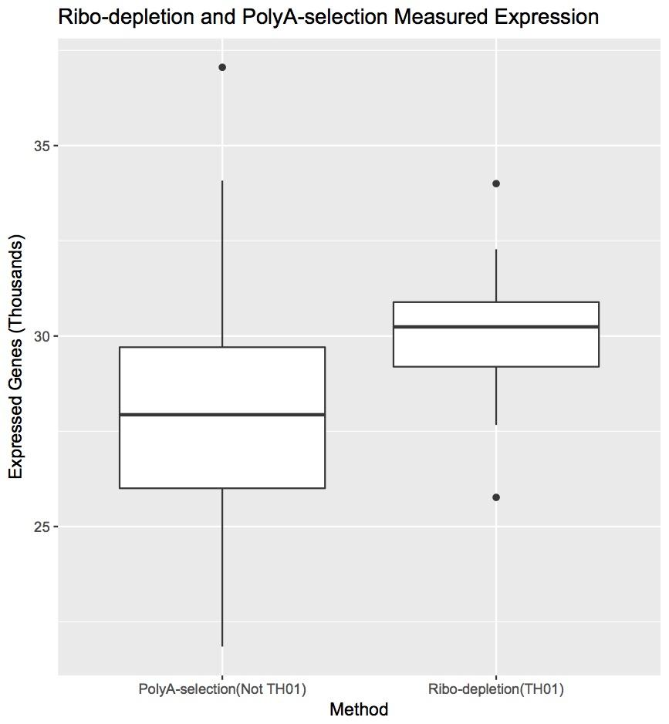
6. Ribo D > PolyA
rel. Exp Genes
Box Plot Ribo-/- | PolyA +
t = 5.121, df = 49.389,
p-value = 5.016e-06
Therefore, true difference in means is not equal to 0
95 percent confidence interval: 1352.013 3097.878
sample estimates:
mean of x 30121.91
mean of y 27896.97
Notes:
Polya is lower in number of expressed genes than ribod
Polya is lower in the line than ribo d

Slide 26
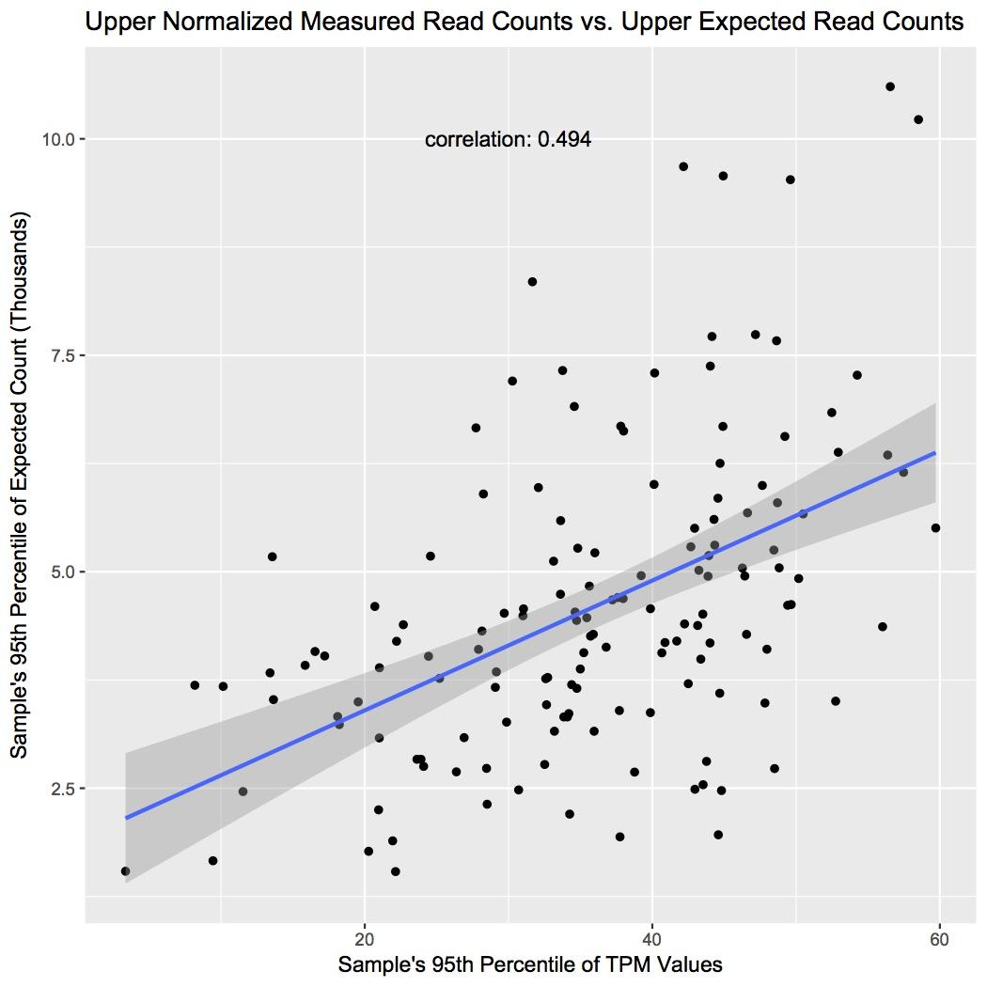
7. p95 expected count vs. p95 TPM
Actual Count
Expected count is not read length normalized, it’s what we expect to see
TPM is read length normalized

Slide 27
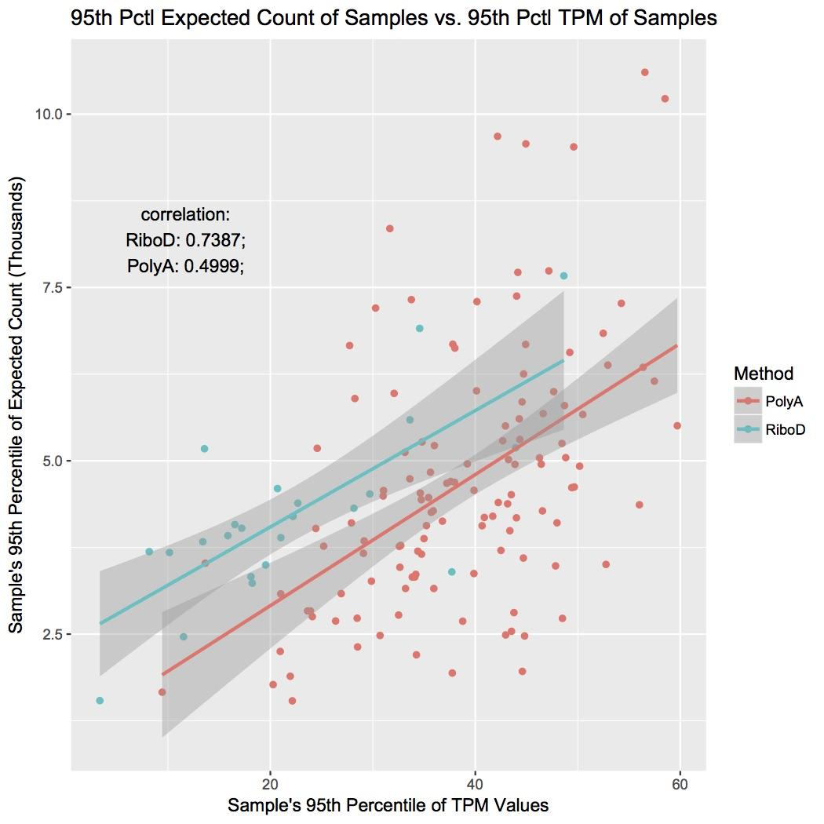
RiboD has less variance of expected and actual read count
RiboD cor = 0.7387
PolyA cor = 0.4999

Slide 28
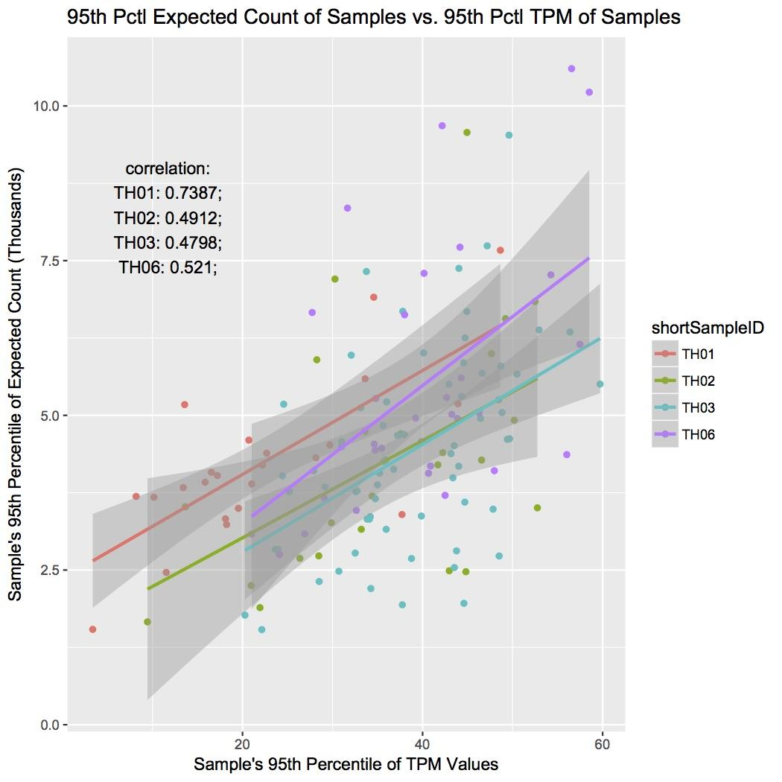
RiboD has the least variance of high expected counts vs TPM
RiboD has the least variance even when comparing against other sample centers

Slide 29
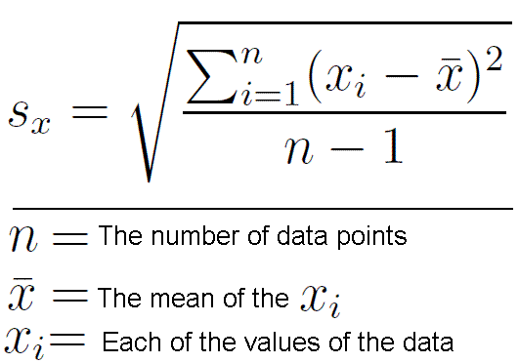
8. Let’s analyze by Gene!
Standard Deviation
Method:
Take most variably expressed genes
Compare the same in each sample.
Variance = SD²

Slide 30
Variance of Genes Calculations
Gene | variation
GFAP | 28.6
COL1A1 | 20.6
TMSB4XP6 | 19.5
COL3A1 | 18.7
COL1A2 | 17.7
SNORA73A | 16.9
AP003041.1 | 16.4
SNORD13 | 15.9
SNORD3A | 15.7
AL162151.3 | 15.6
Top 5% of the data variates from the mean by 2.56
the overall mean is 1.019 log2(TPM+1) pan-sample
average standard deviation of genes differing from the mean is 0.56
dfGeneVar <- outlierResults %>%
group_by(Gene) %>%
summarize(variation = var(sample)) %>%
arrange(desc(variation))

Slide 31
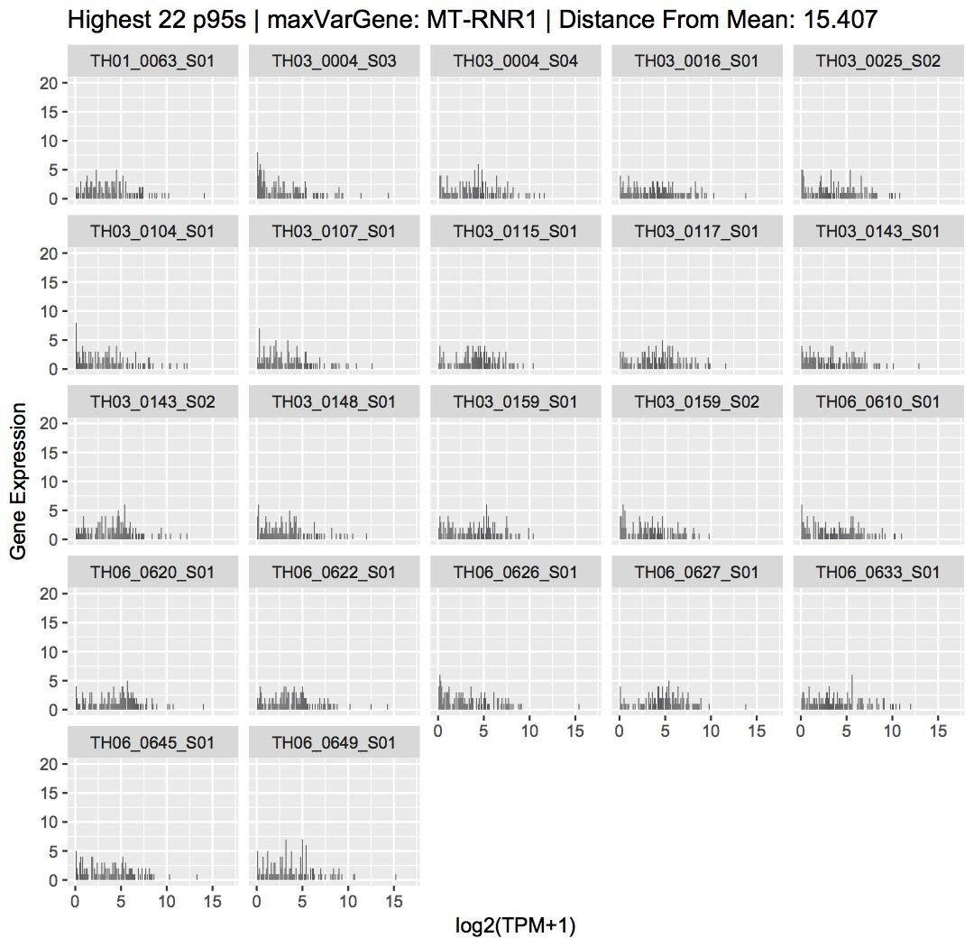
← Samples with High gene expr variance
22 Highest 95 pctls

Slide 32
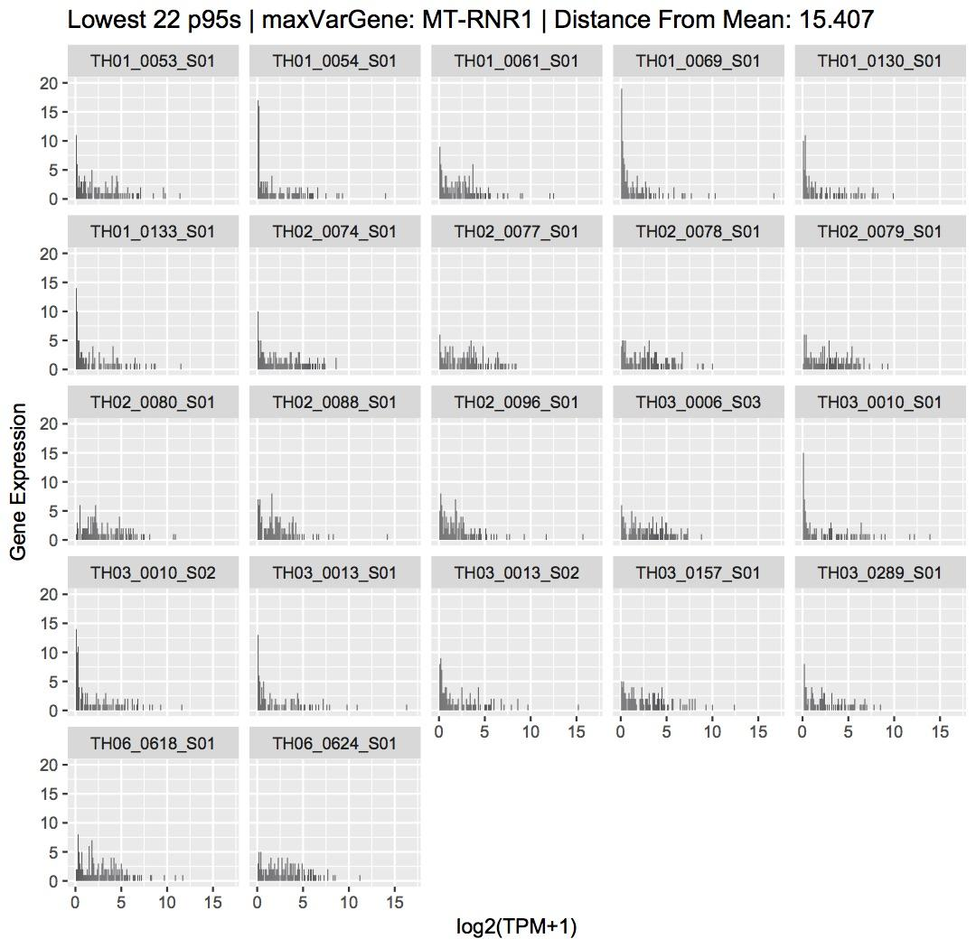
← Samples with High gene expr variance
22 Lowest 95th Pctls
Slightly lower log2(TPM+1) than highest 22 95th pctls

Slide 33
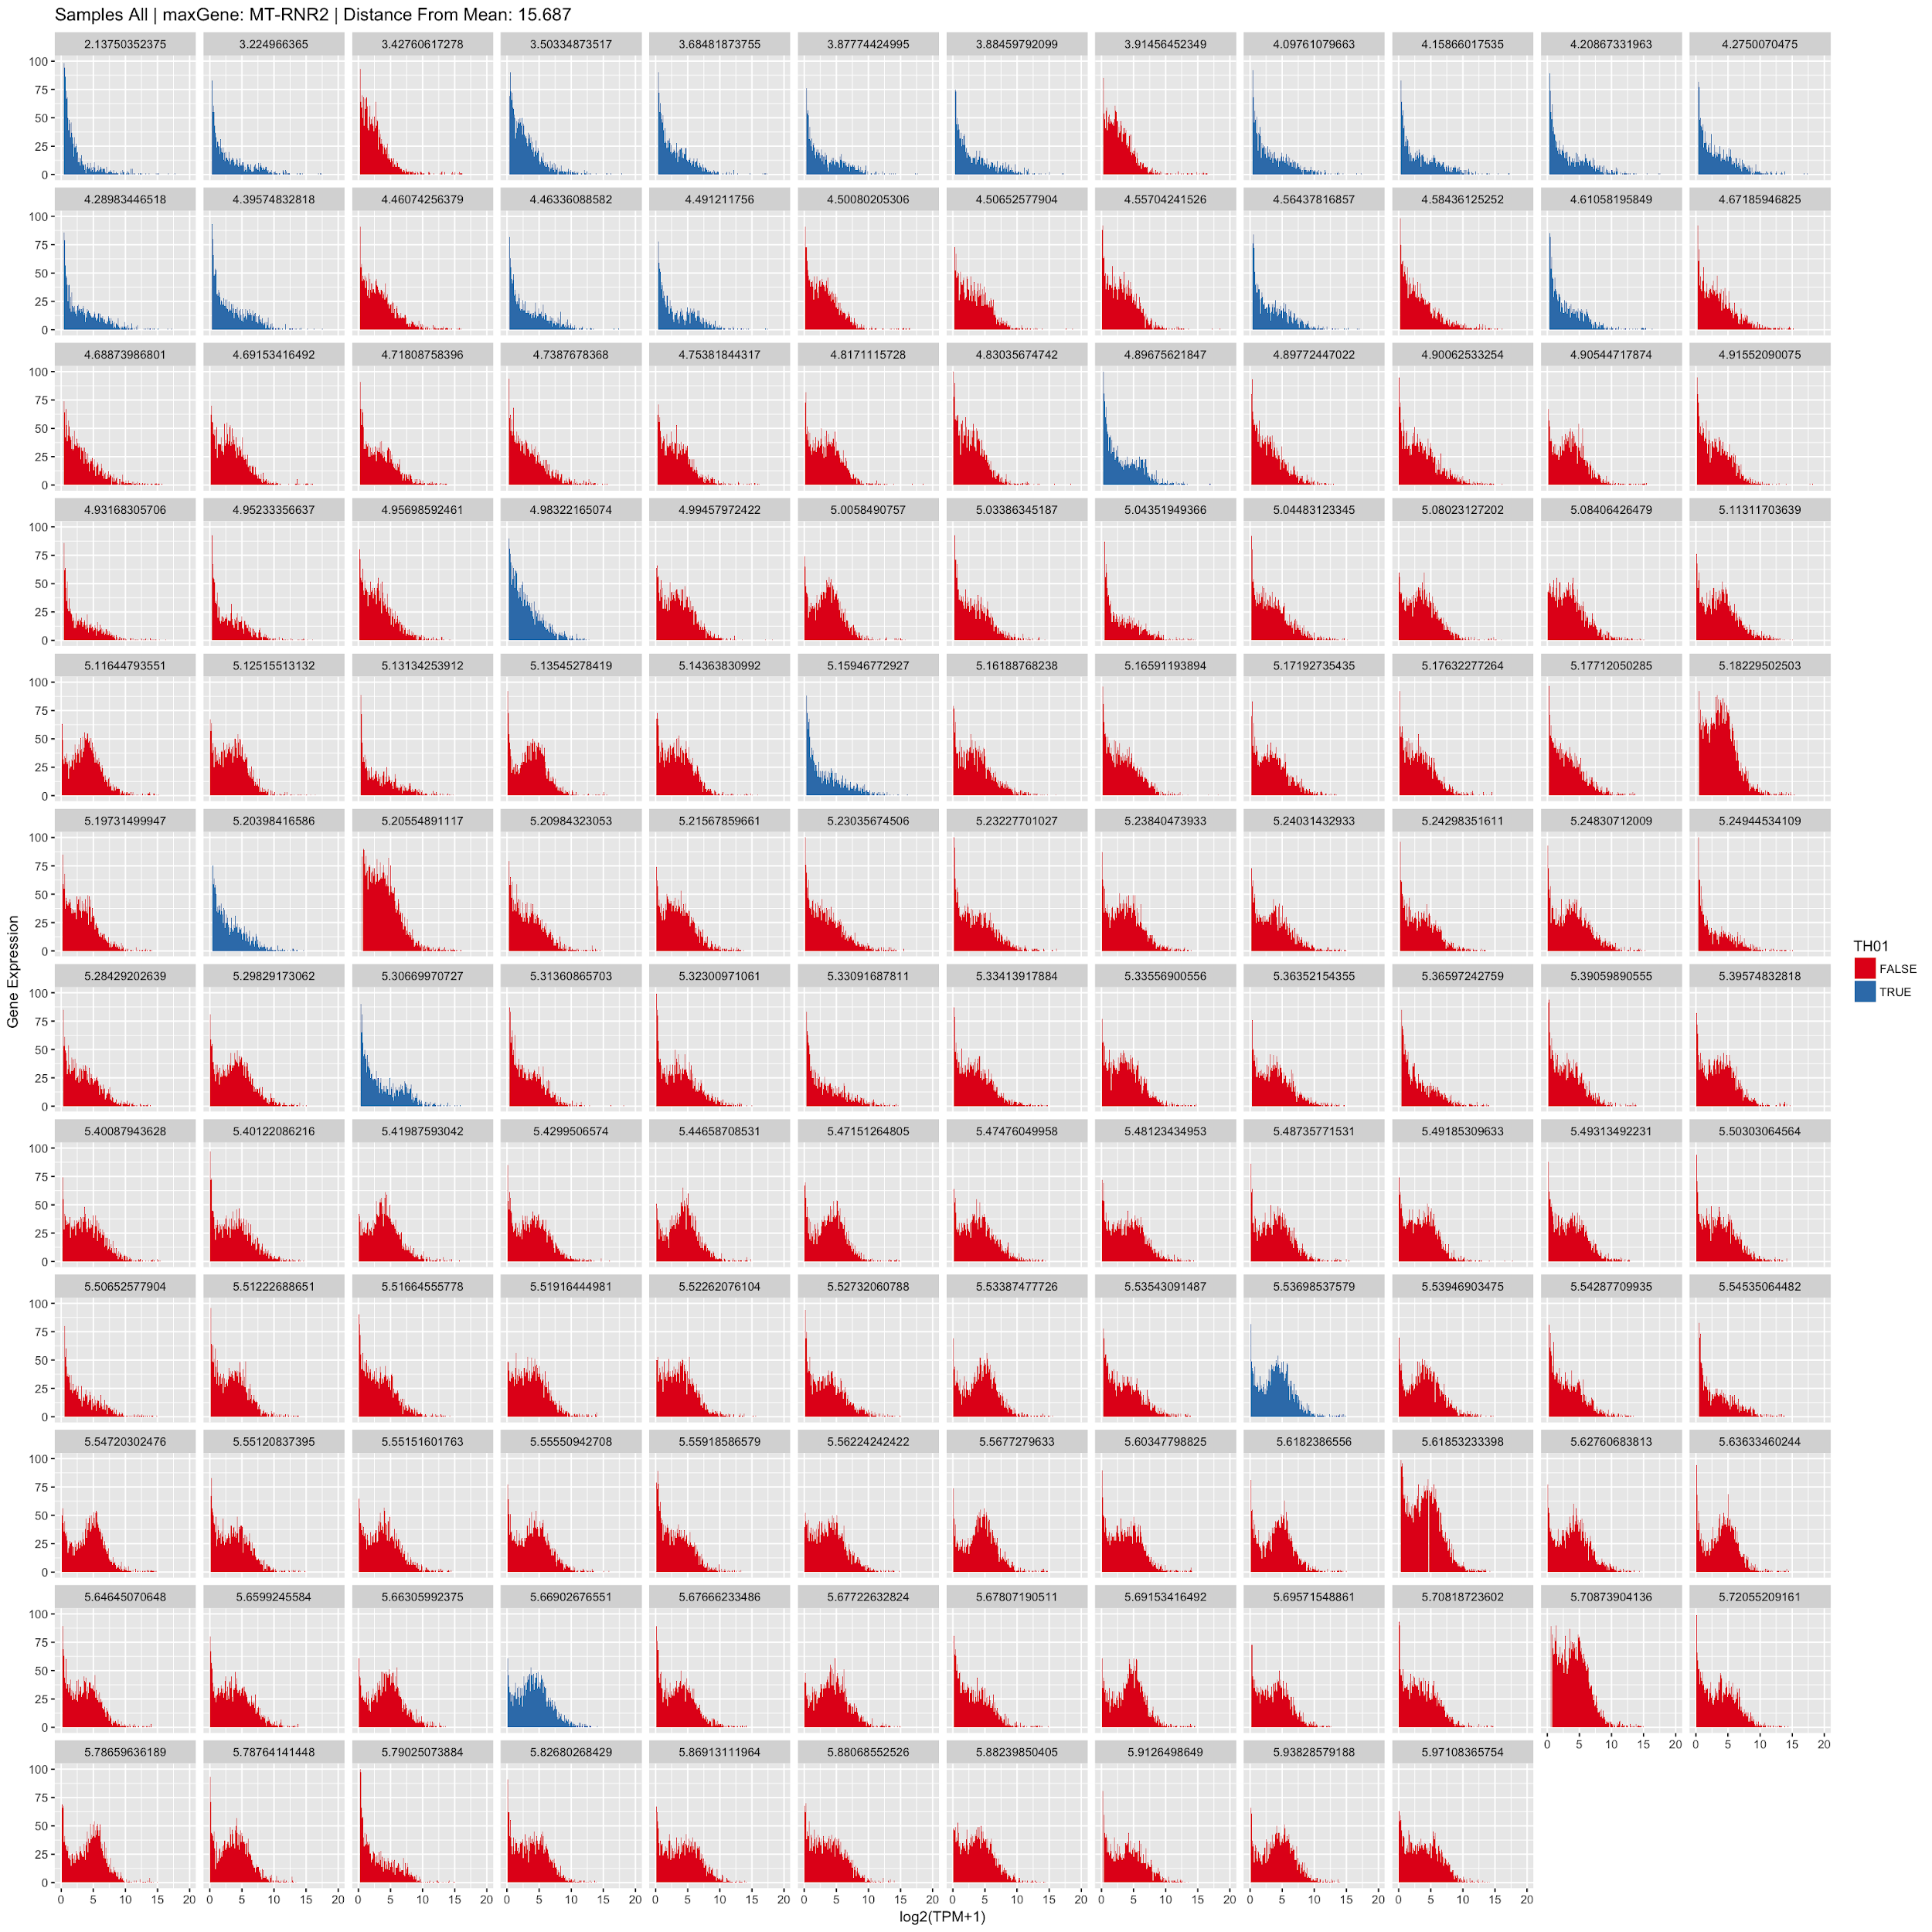
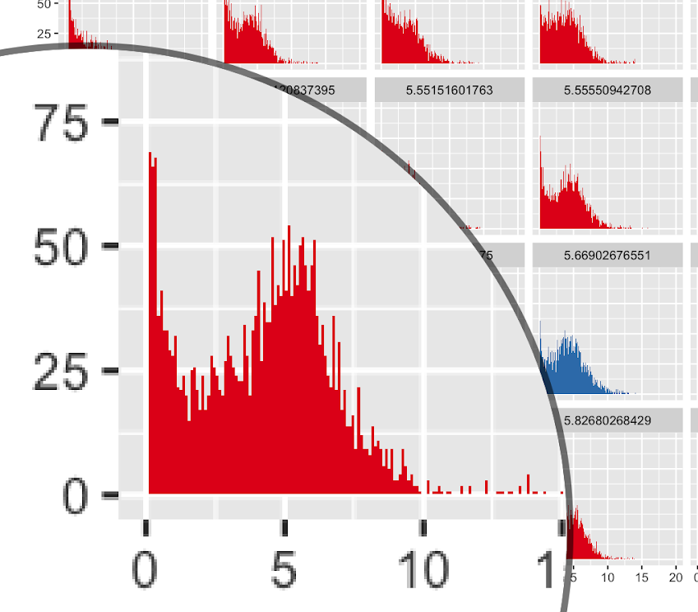
Highest Gene Variance pan-sample
Non TH01 have mostly square distributions
vs.
142 samples plotted
Gene Expression
log2(TPM+1)

Slide 34
No Difference in low p95 and high p95 genes with high variability

Slide 35
Results full
Plot every patient’s expression values (hists)
There was half of the genes expressed (we assumed other half was unexpressed)
Plot the distribution of 95pctl per sample (hist)
There are high and low 95th pctls
Why? because of RiboD / PolyA difference
Plot gene expression vs. 95th pctl per sample (scatter)
expression count doesn’t affect patients 95th pctl pan-sample and pan-center
TH01 sample center = positive correlation p95/unexpression count (47.6%)
Plot UMEND count vs. 95th pctl pan-sample (scatter)
UMEND read doesn’t affect p95 pan-sample and pan-center
TH01 sample center = positive correlation p95/UMENDread (70.1%)
Method RiboD vs. PolyA 95th pctl (boxplot)
RiboD 95th Pctl pan-sample < PolyA 95th Pctl pan-sample

Slide 36
Results full
Method RiboD vs. PolyA Expression (boxplot)
RiboD Expressed Genes > PolyA Expressed Genes
Plot 95th pctl of expected_count vs. 95th pctl of TPM (scatter)
RiboD has less variance comparing actual count to depth of sequencing
High variance genes (hists)
Samples with high gene variance have similar distributions no matter their 95th pctl

Slide 37
Code to calculate Variance and Mean
quantile(dfGeneVar$variation, 0.95)
# > 95% of the data variates from the mean by 2.56
geneList <- dfGeneVar %>% filter(variation > quantile(dfGeneVar$variation, 0.95))
# get names of genes p95 of variation and up
dfSamples <- outlierResults %>% group_by(sampleID) %>% filter(Gene %in% geneList$Gene)
# match names to all of their th01 th02 etc...
mean(dfGeneMean$mean)
# the overall mean is 1.019 sample
dfGeneVar <- outlierResults %>%
group_by(Gene) %>%
summarize(variation = var(sample)) %>%
arrange(desc(variation))
mean(dfGeneVar$variation) # 0.56
# so most genes differ from the norm on average by 0.56
sd(dfGeneVar$variation) # standard deviation = 1.15
summary(dfGeneVar)
# Gene variation
# Length:58581 Min. : 0.000000
# Class :character 1st Qu.: 0.001579
# Mode :character Median : 0.069611
# Mean : 0.565726
# 3rd Qu.: 0.707318
# Max. :28.579563

Slide 38
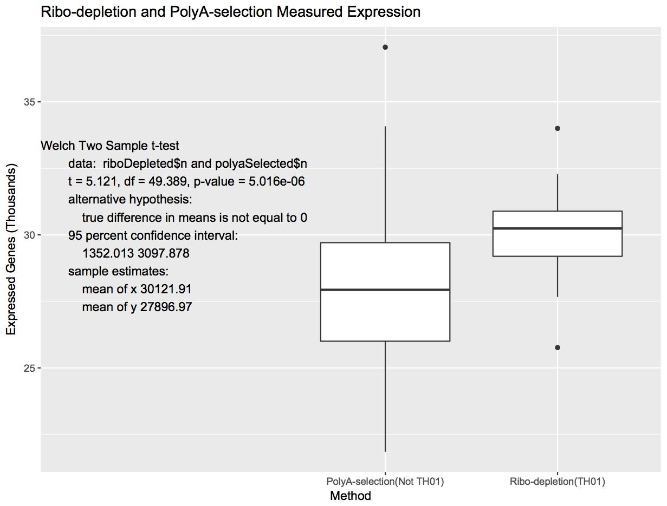
Reference In R Code
ggplot(dfBox, aes(x=Method, y=n/1000)) + geom_boxplot()+
ylab('Expressed Genes (Thousands)') + xlab('Method') +
ggtitle('Ribo-depletion and PolyA-selection Measured Expression')
annotate("text",x = -1,y = 30 , hjust =0,
label = paste0( "Welch Two Sample t-test...)
)
riboDepleted <- filter(dfBox,
Method=="Ribo-depletion(TH01)")
polyaSelected <- filter(dfBox,
Method=="PolyA-selection(Not TH01)")
t.test(riboDepleted$n, polyaSelected$n,
alternative = "two.sided",
mu = 0, paired = FALSE, var.equal = FALSE,
Conf.level = 0.95)
R output

Slide 39
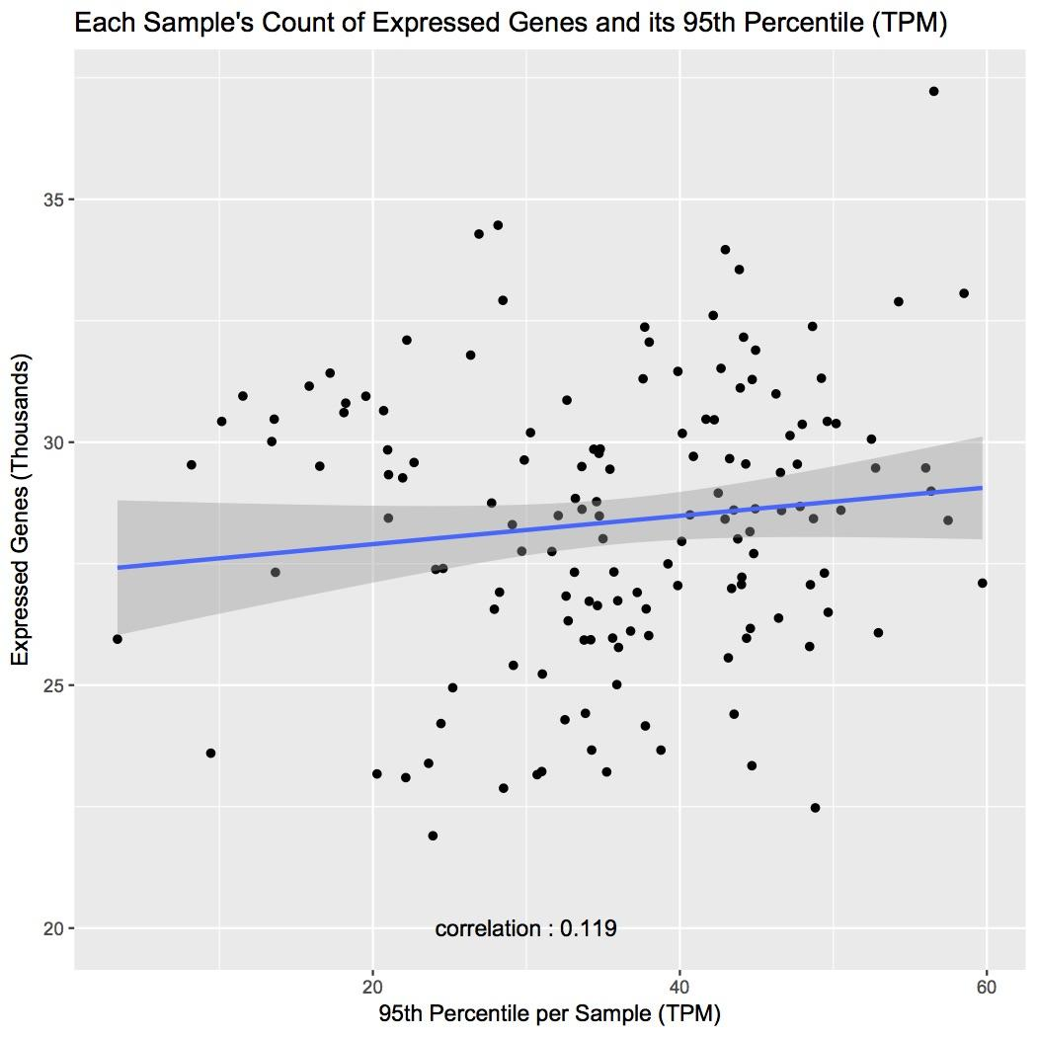
TPM increases, p95 doesn’t change

Slide 40
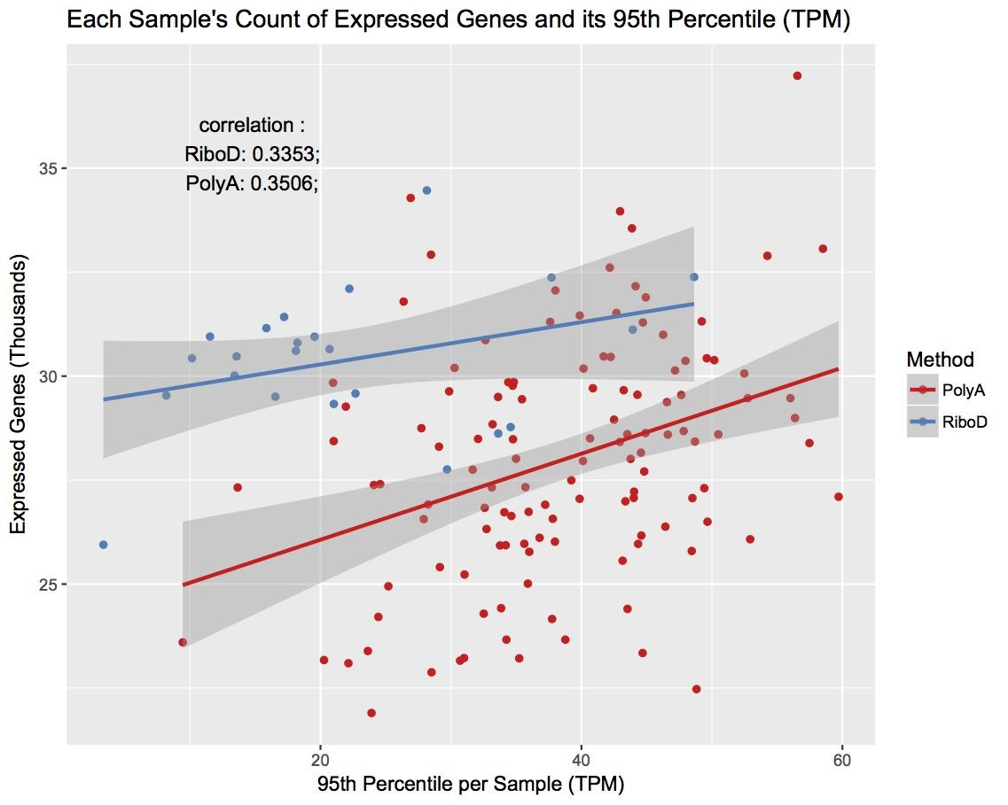
RiboD vs PolyA
TPM
Same correlation
RiboD has more expressed genes

Slide 41
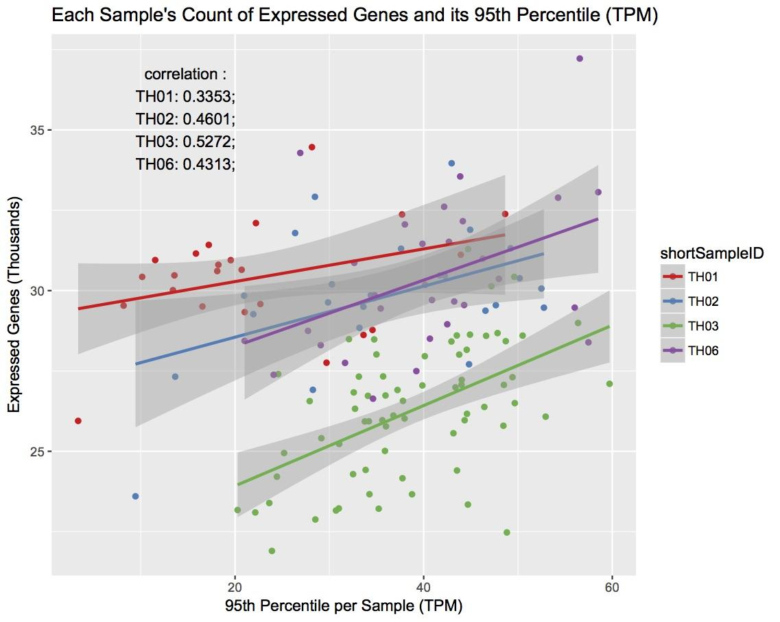
TH03 has the
Most correlation
TH03- low expression, high 95th pctls

Slide 42
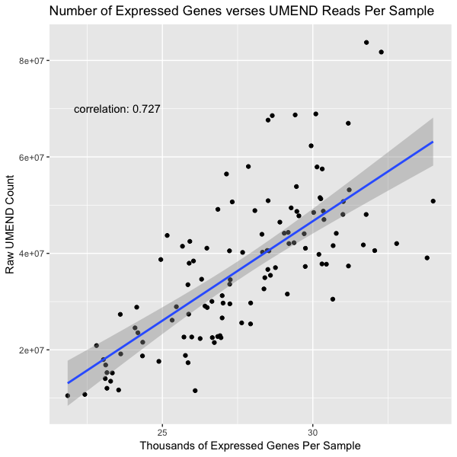
More UMEND reads = More Expressed Genes
More UMEND = more expressed Genes per sample
72.7% Correlation

Slide 43
Ideas (old)
22 best/worst counts histogram for expected_count
Get back values from ggplot
Get values its going to plot
Pick max y val greater than 2 log2(TPM+1)
Find max using calculus with density points

Slide 44
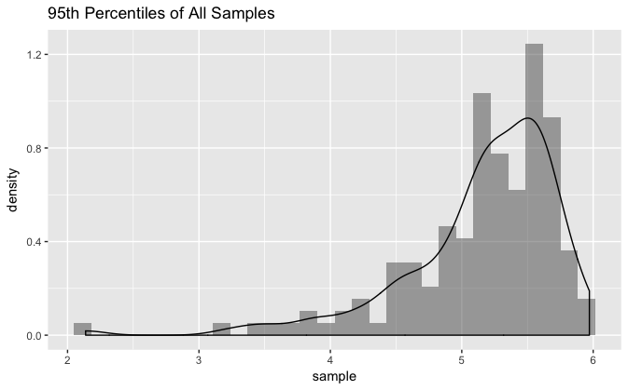
Sum to 1?

Slide 45
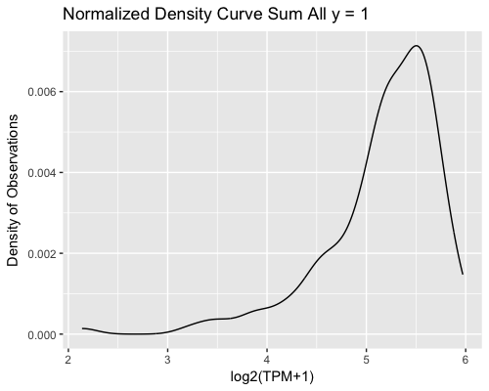
( )
m <- ggplot(percentileOfEachSampleDf, aes(p95))
m <- m + geom_density()sum(p$data[[1]]$y)
# sum of data is 173.9702
# I want to divide the points of the density
p <- print(m)
head(p$data[[1]]$y)
by the sum of all to get a normalized curve that adds to one
normalized <- data.frame(p$data[[1]]$y,p$data[[1]]$x)
sum(p$data[[1]]$y/sum(p$data[[1]]$y))
# this sum is 1
ggplot(normalized, aes(p$data[[1]]$x, p$data[[1]]$y/sum(p$data[[1]]$y))) + geom_line() +
ggtitle("Normalized Density Curve Sum All y = 1") +
ylab("Density of Observations") +
xlab("log2(TPM+1)")

Slide 46
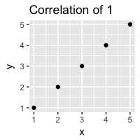
cor(dfScatter$n,dfScatter$p95)
# 0.08755389
# about 8.8% correlation
# REFERENCE
x <- seq(1,5)
y <- x
df = data.frame(x,y)
cor(x,y)
ggplot(df, aes(x,y)) + geom_point() + ggtitle("Correlation of 1")
# correlation of 1 (when x = y)

Slide 47
Cohorts Used
Ckcc rsem genes → Raw TPM values of each sample
Ckcc comp4.3 tert8 → Log₂(TPM+1) values of each sample
TPM
Normalizes all gene expression from RNA seq reads
Transcripts Per Kilobase Million
Divide the read counts by length of each gene in Kb
Add all of these up and divide by 1,000,000 (scaling factor)

Slide 48
Sum of TPM Values
sum_TPMDf <- rawTPMDf %>%
group_by(sampleID) %>%
summarise(sum = sum(TPM))
sampleID sum
<chr> <dbl>
1 TH01_0053_S01_rsem_genes.results 1000000
2 TH01_0054_S01_rsem_genes.results 1000000
3 TH01_0055_S01_rsem_genes.results 1000000
4 TH01_0061_S01_rsem_genes.results 999998
5 TH01_0062_S01_rsem_genes.results 1000000
6 TH01_0063_S01_rsem_genes.results 1000000
7 TH01_0064_S01_rsem_genes.results 1000000
8 TH01_0069_S01_rsem_genes.results 999998
9 TH01_0120_S01_rsem_genes.results 999999
10 TH01_0121_S01_rsem_genes.results 1000001
# ... with 136 more rows
min(sum_TPMDf$sum)
[1] 999997.7
max(sum_TPMDf$sum)
[1] 1000001
Sum of all TPM values for each sample are 1,000,000 ± 1 TPM

